Slide 1
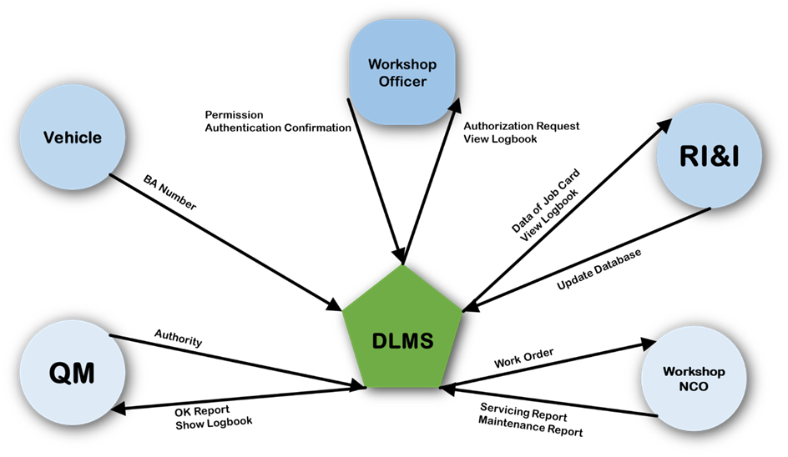
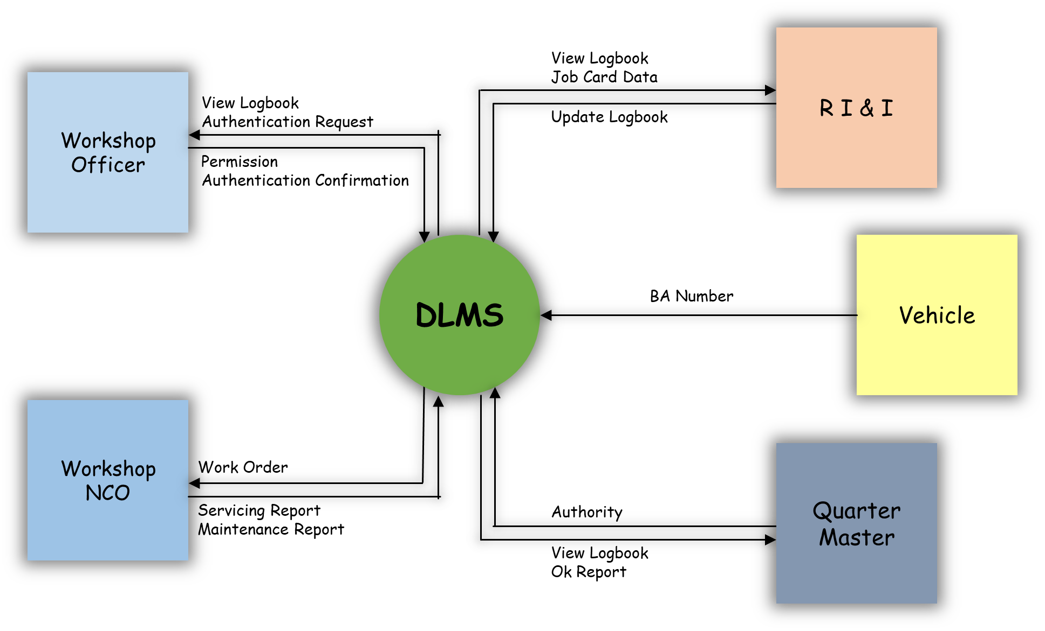


Slide 2
R I & I
View Logbook
Job Card Data
Workshop Officer
View Logbook
Authentication Request
Update Logbook
Permission
Authentication Confirmation
DLMS
Vehicle
BA Number
Workshop NCO
Work Order
Quarter Master
Servicing Report
Maintenance Report
Authority
View Logbook
Ok Report

Slide 3
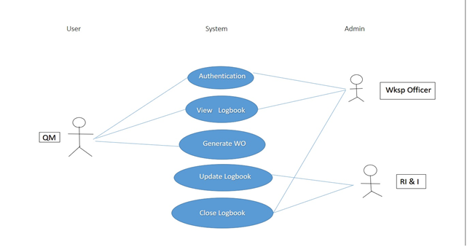
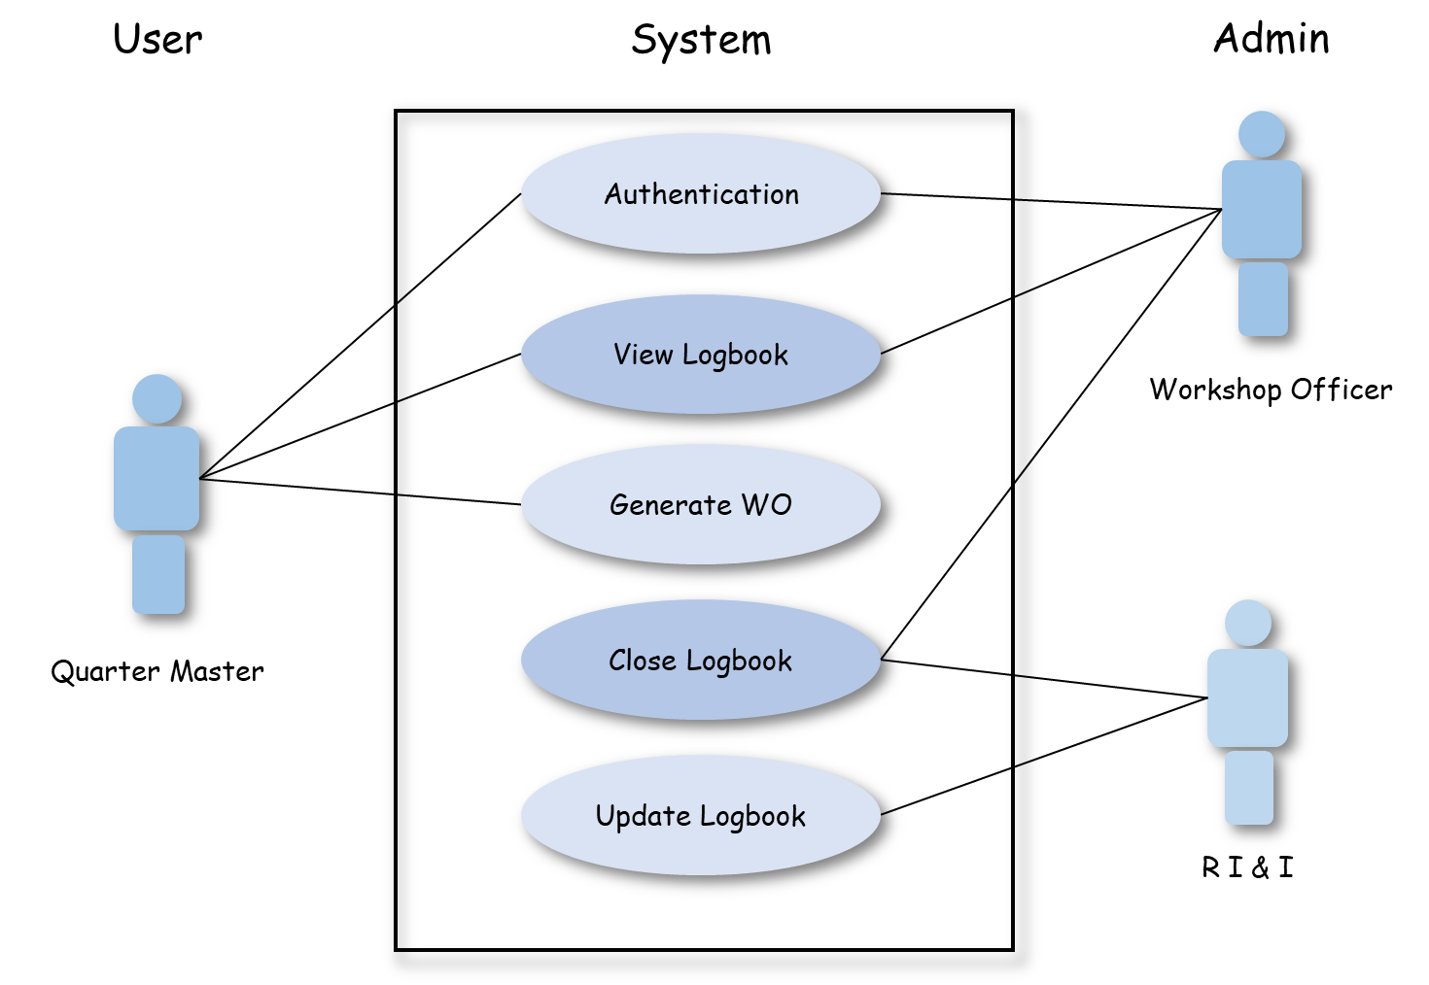

Slide 4
User
System
Admin
Authentication
View Logbook
Workshop Officer
Generate WO
Close Logbook
Quarter Master
Update Logbook
R I & I

Slide 5
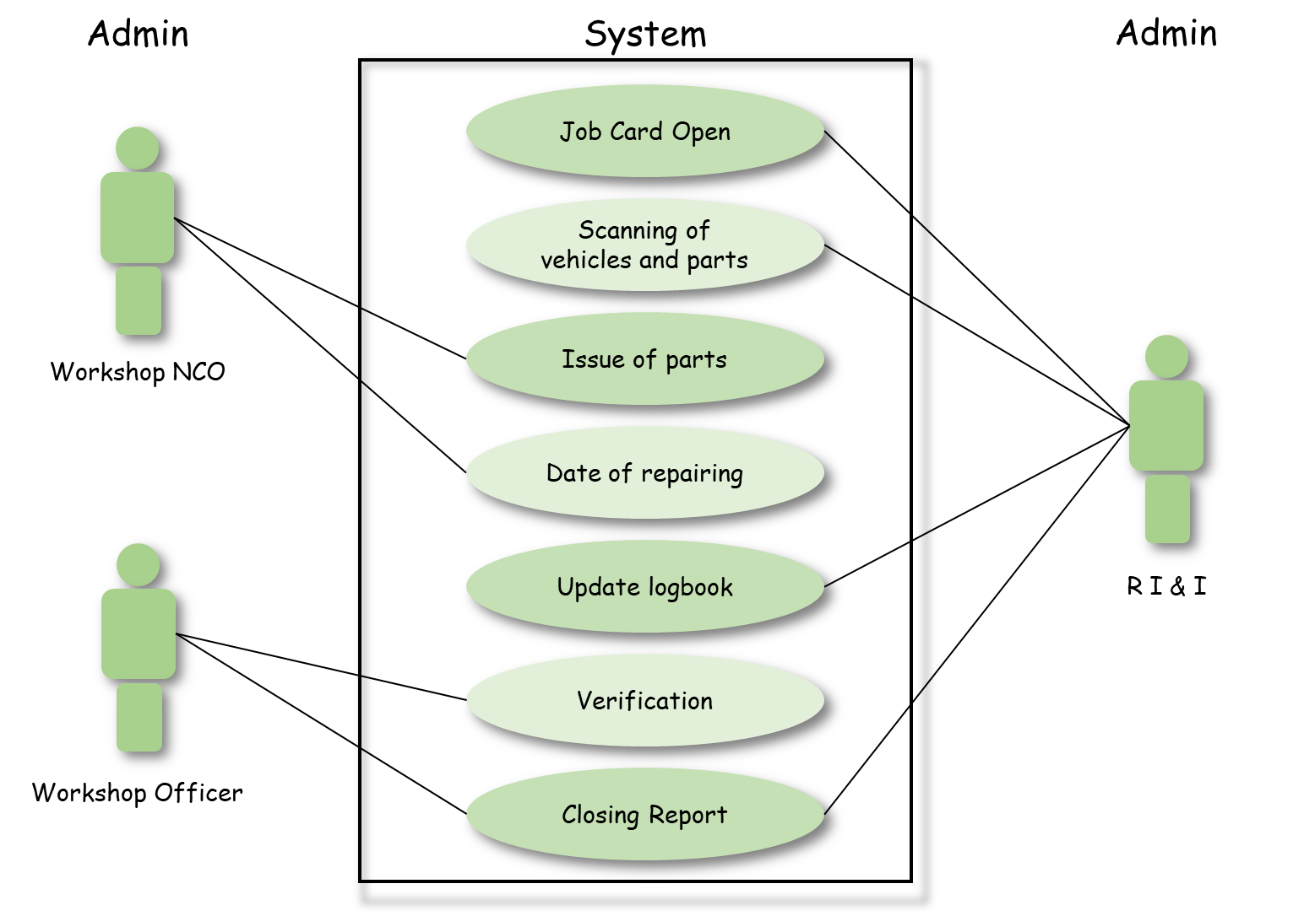
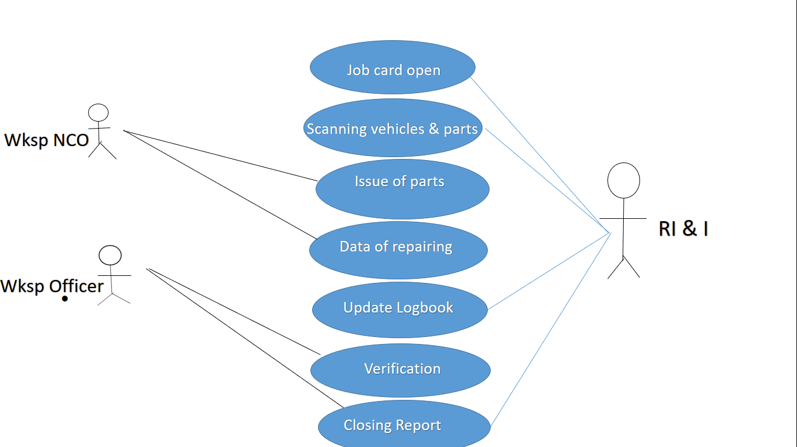
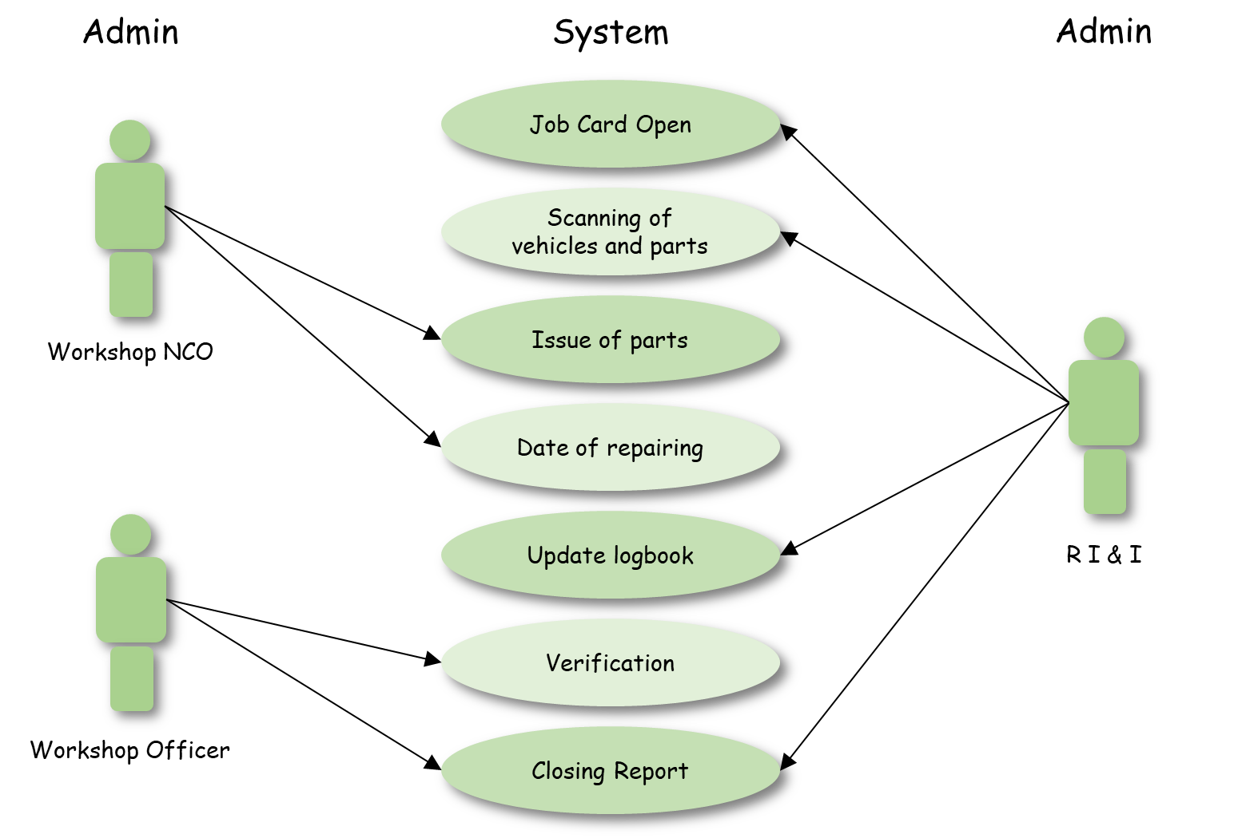

Slide 6
Admin
System
Admin
Job Card Open
Scanning of vehicles and parts
Issue of parts
Workshop NCO
Date of repairing
Update logbook
R I & I
Verification
Workshop Officer
Closing Report

Slide 7
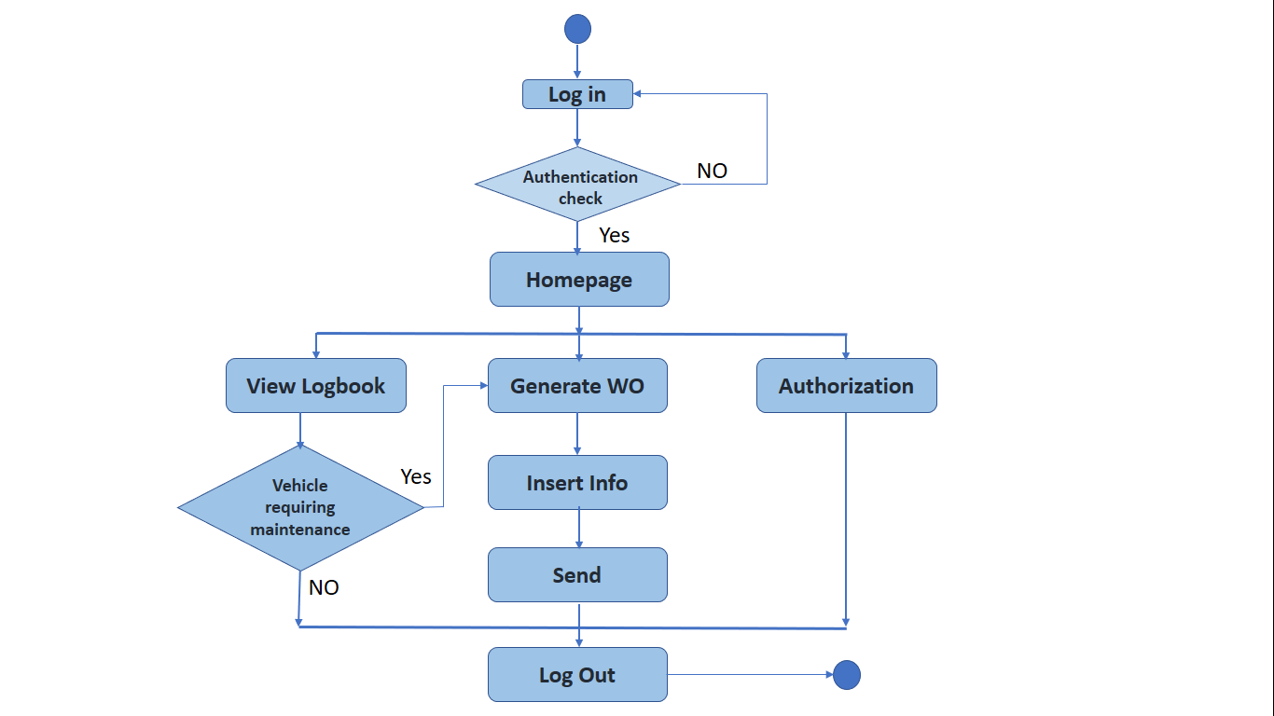
Log in
No
Authentication
check
Yes
View Logbook
Homepage
Vehicle require maintenance
Yes
Generate WO
Insert Info
No
Authorization
Send
Log Out

Slide 8
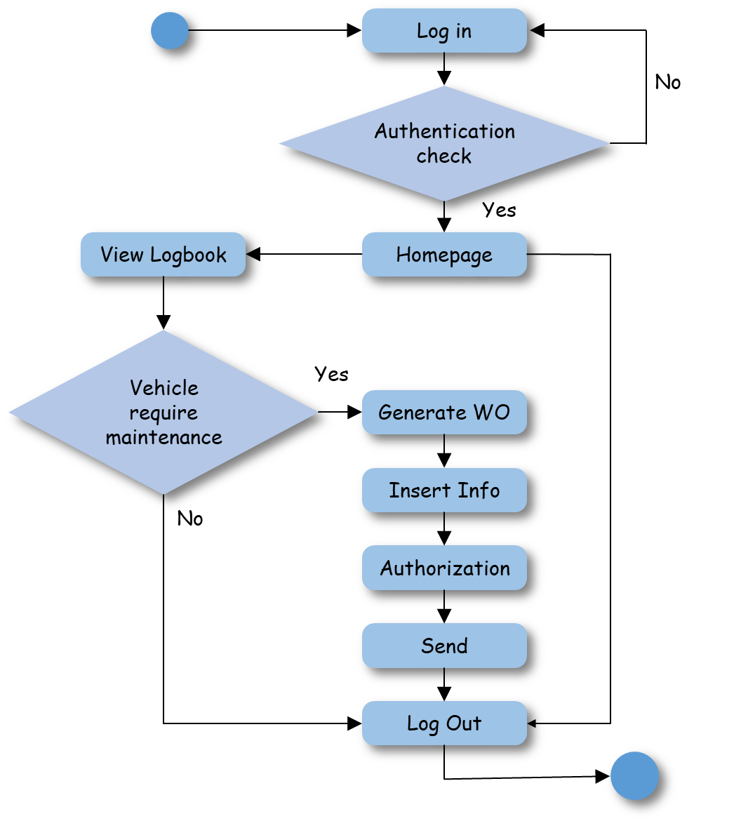

Slide 9
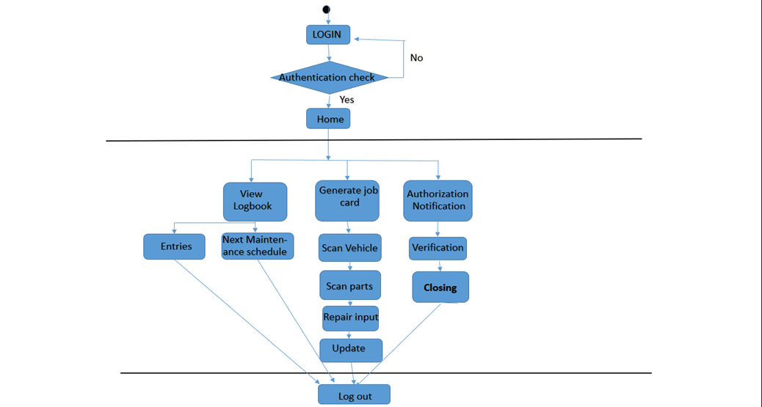
Login
No
Authentication Check
Yes
Home
View Logbook
Generate Job Card
Authorization Notification
Entries
Next Maintenance Date
Scan vehicle
Verification
Scan parts
Closing
Repair Input
Update
Log Out

Slide 10
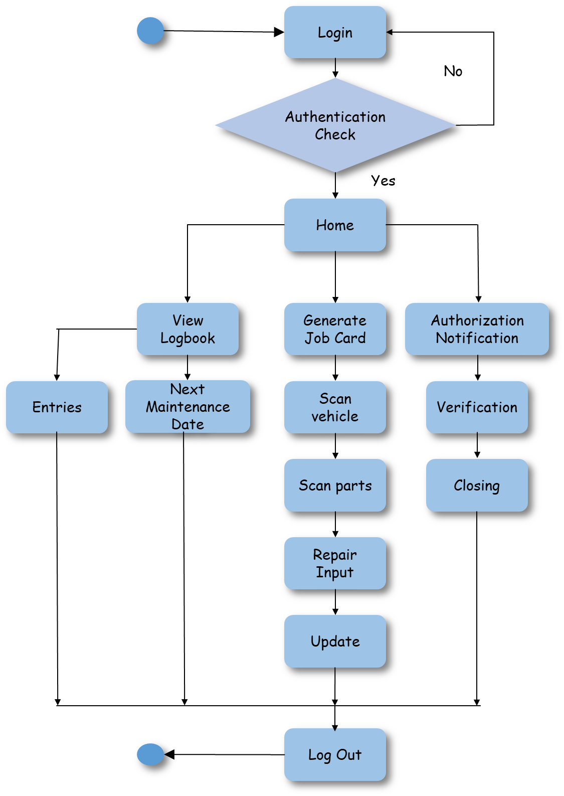

Slide 11


Slide 13

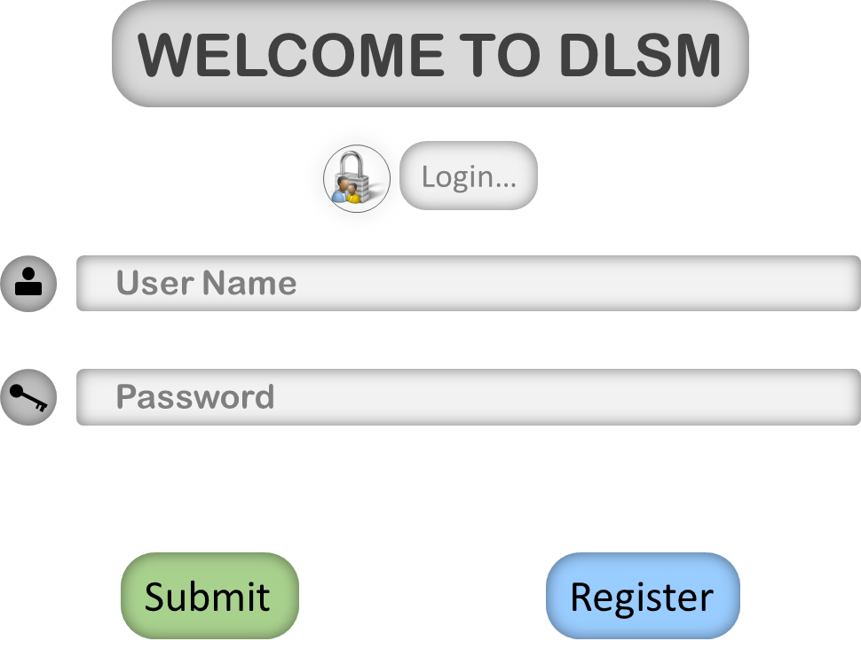
WELCOME TO DLSM
Login…
User Name
Password
Submit
Register

Slide 14
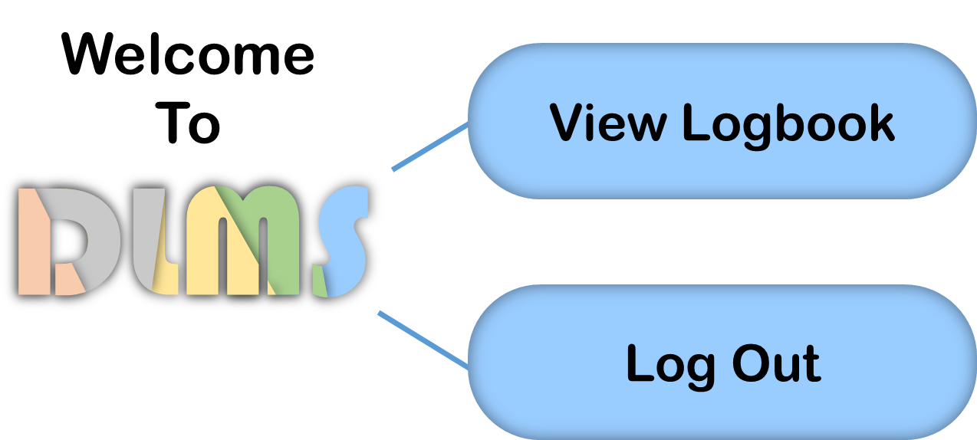
Welcome To
View Logbook
Log Out

Slide 15
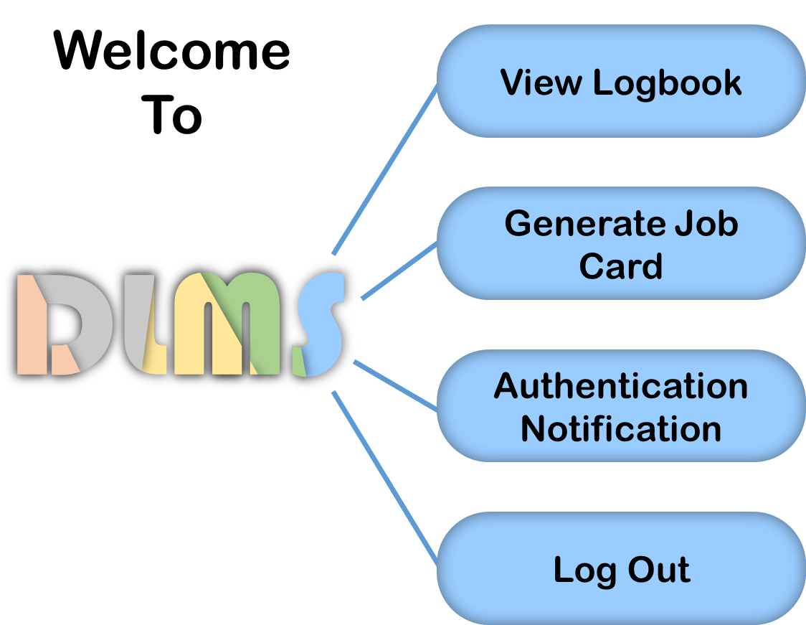
Welcome To
View Logbook
Generate Work Order
Authentication Notification
Log Out

Slide 16
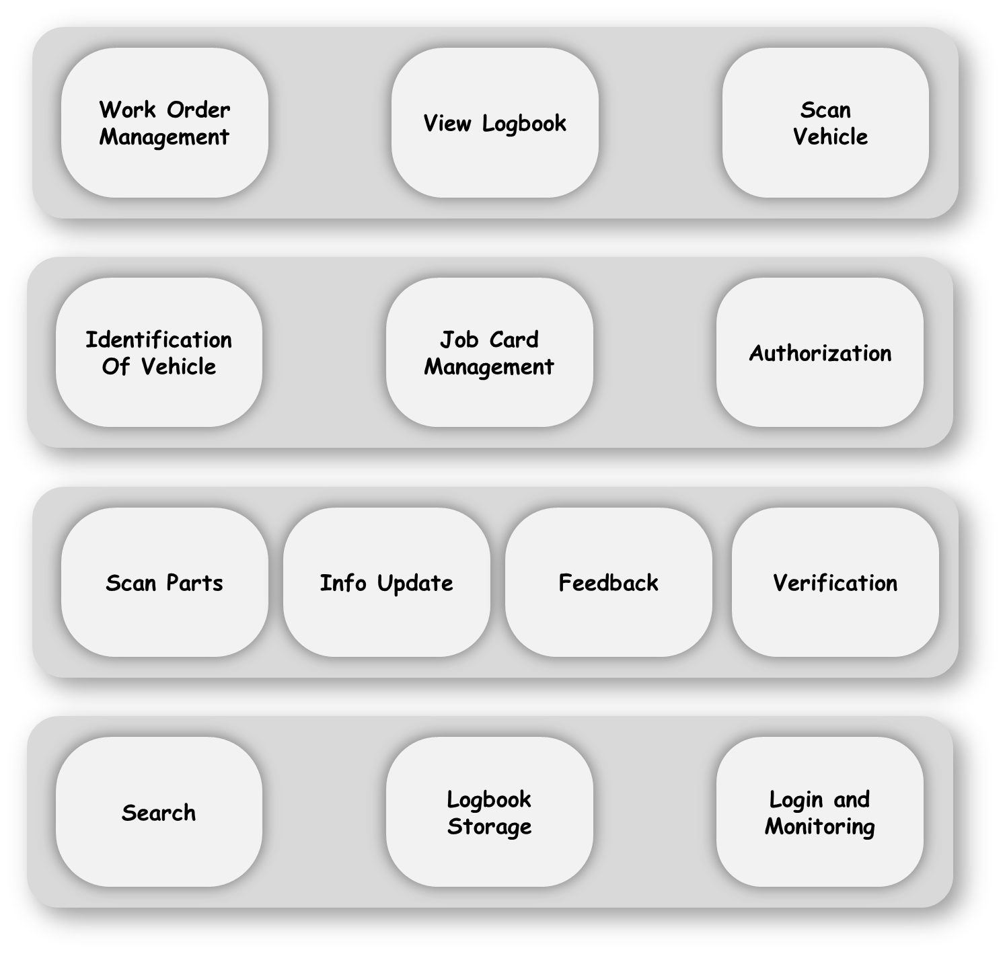
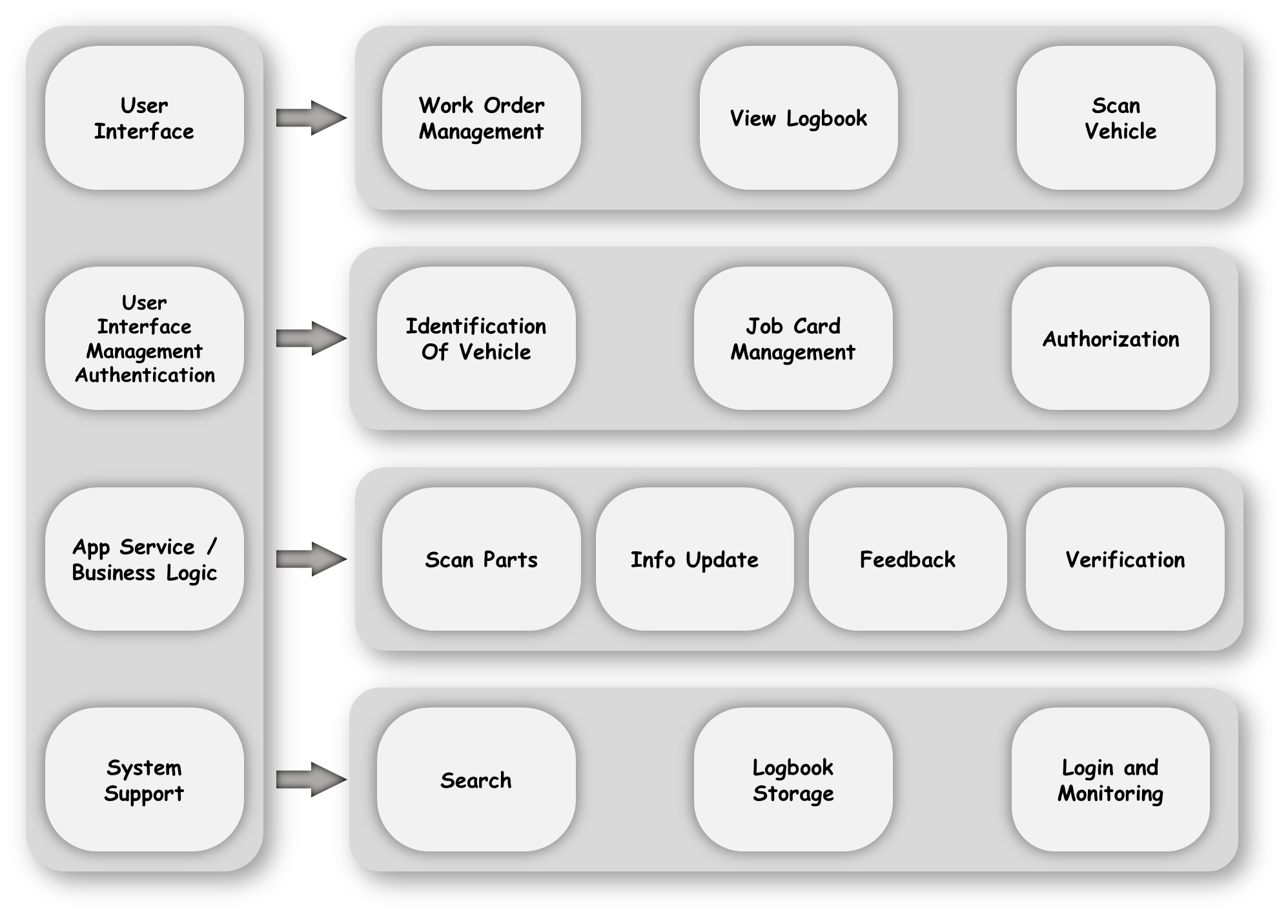
User Interface
Work Order Management
View Logbook
Scan
Vehicle
User Interface Management Authentication
Identification Of Vehicle
Job Card Management
Authorization
App Service /
Business Logic
Scan Parts
Info Update
Feedback
Verification
System Support
Search
Logbook Storage
Login and Monitoring

Slide 17
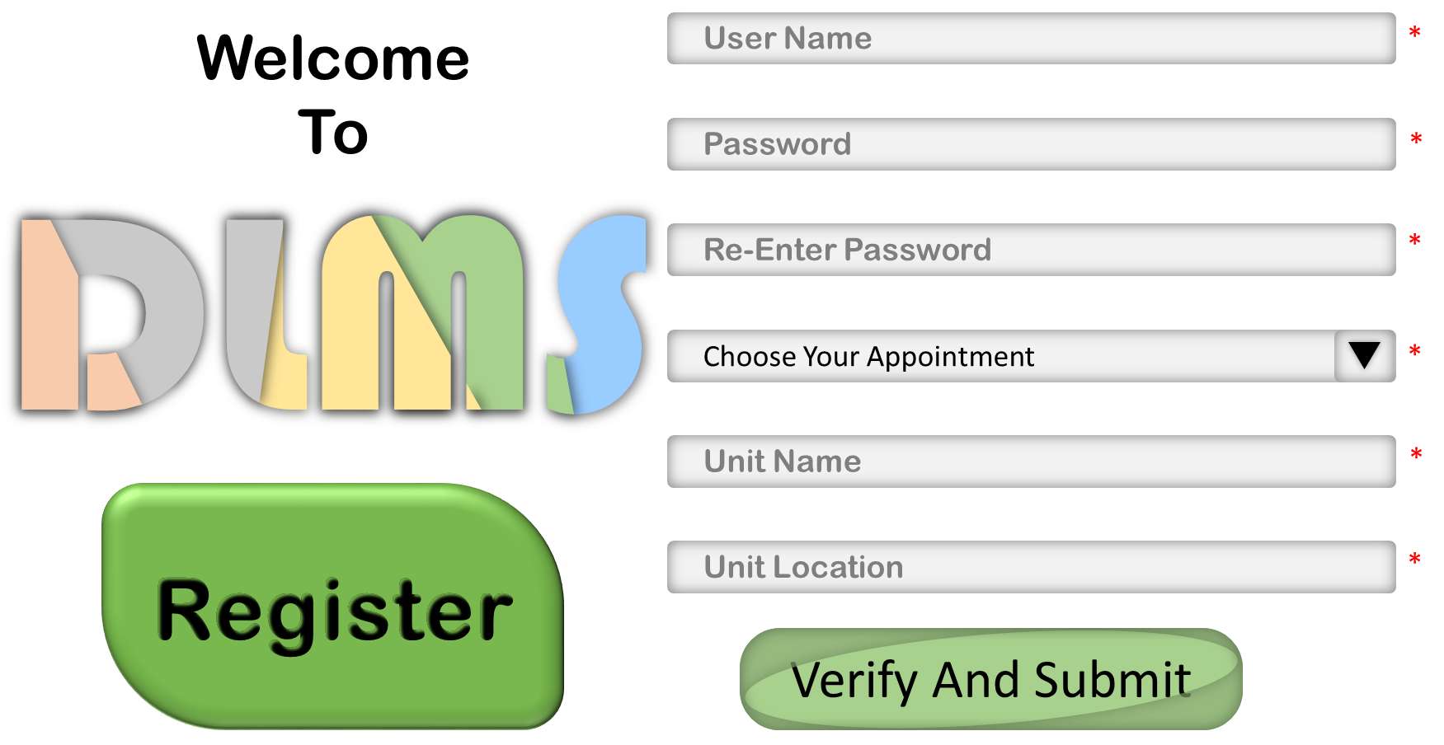
Welcome To
User Name
*
Password
*
Re-Enter Password
*
Choose Your Appointment
*
Unit Name
*
Register
Unit Location
*
Verify And Submit

Slide 18
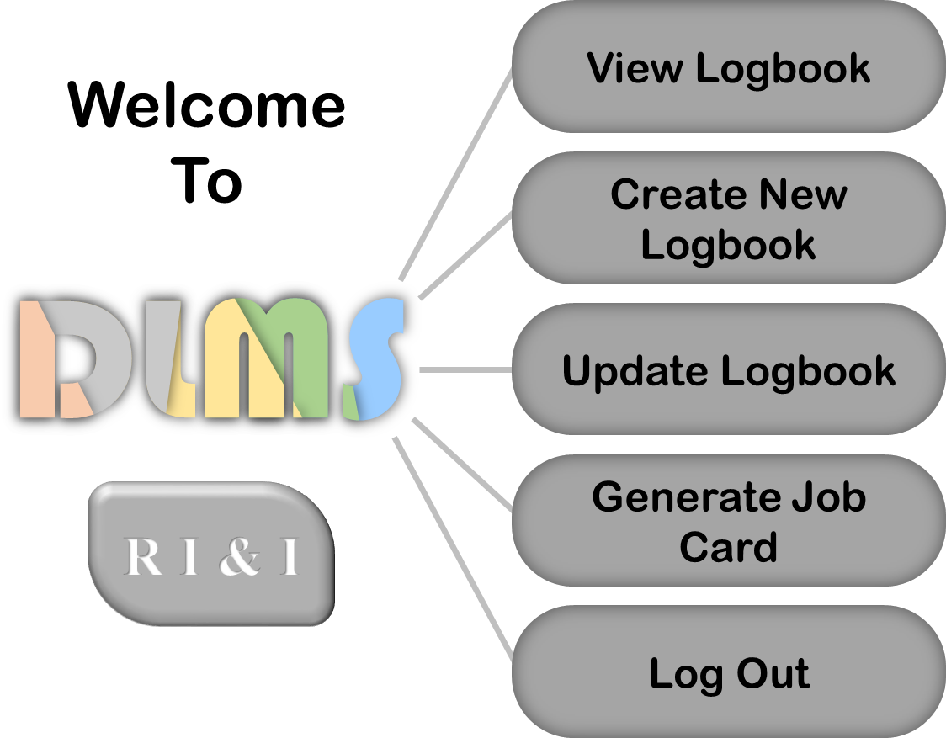
View Logbook
Welcome To
Create New Logbook
Update Logbook
Generate Job Card
R I & I
Log Out

Slide 19
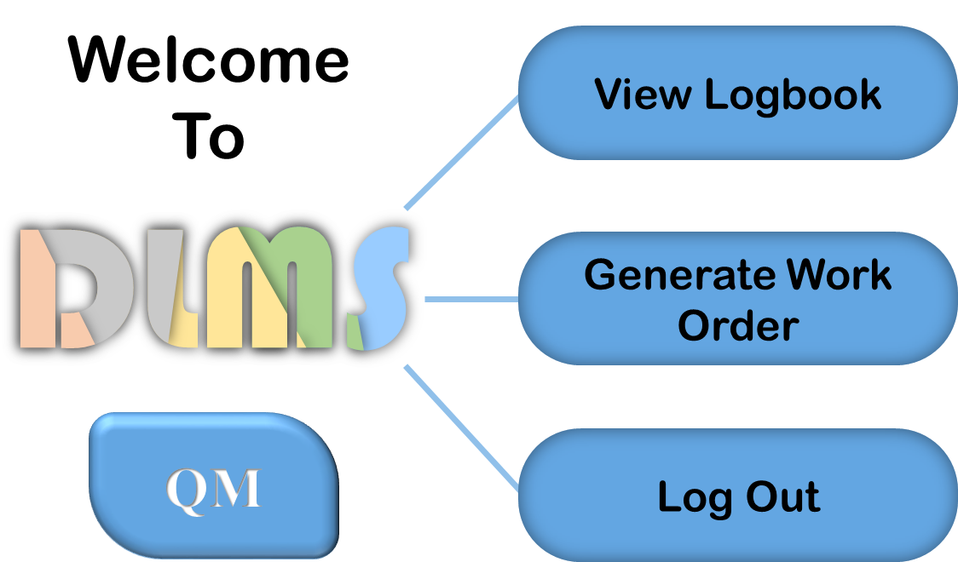
Welcome To
View Logbook
Generate Work Order
QM
Log Out

Slide 20
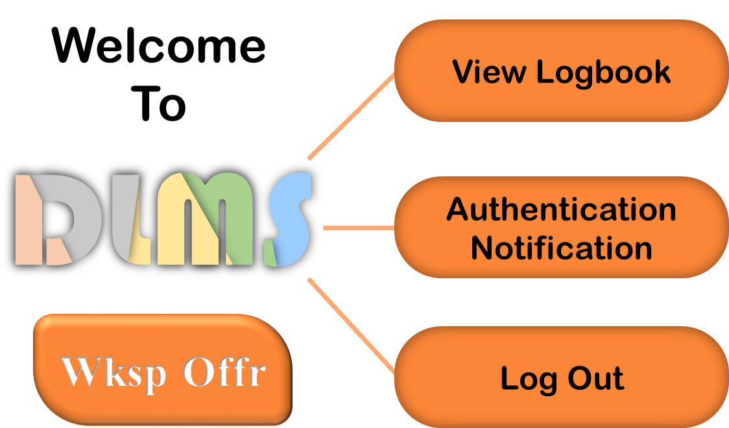
Welcome To
View Logbook
Authentication Notification
Wksp Offr
Log Out

